Slide 1
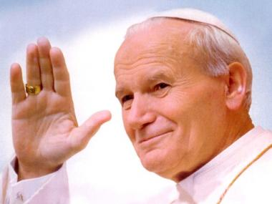
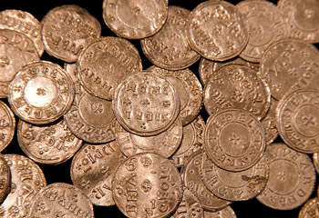
John Paul II was the greatest economist?
How profit relates to
eternal life?
Sarolta Laura Baritz OP

Slide 2
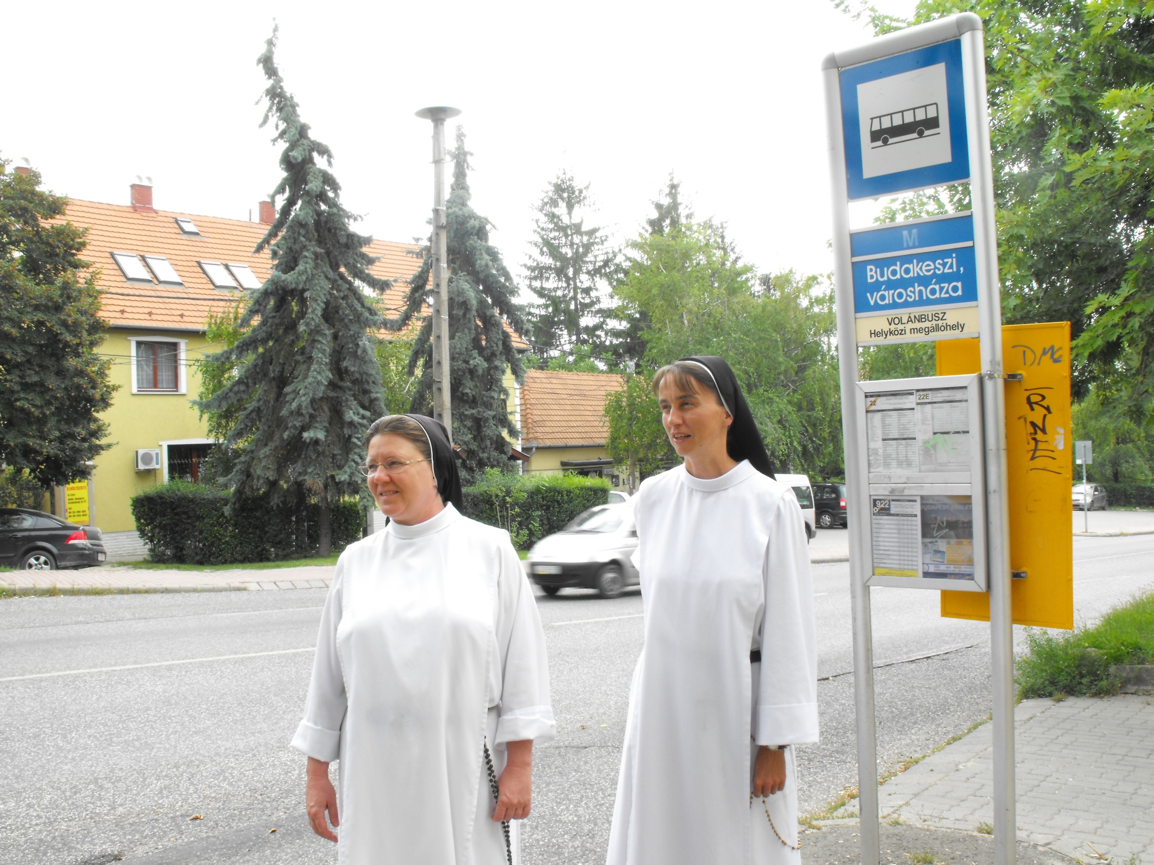

Slide 3
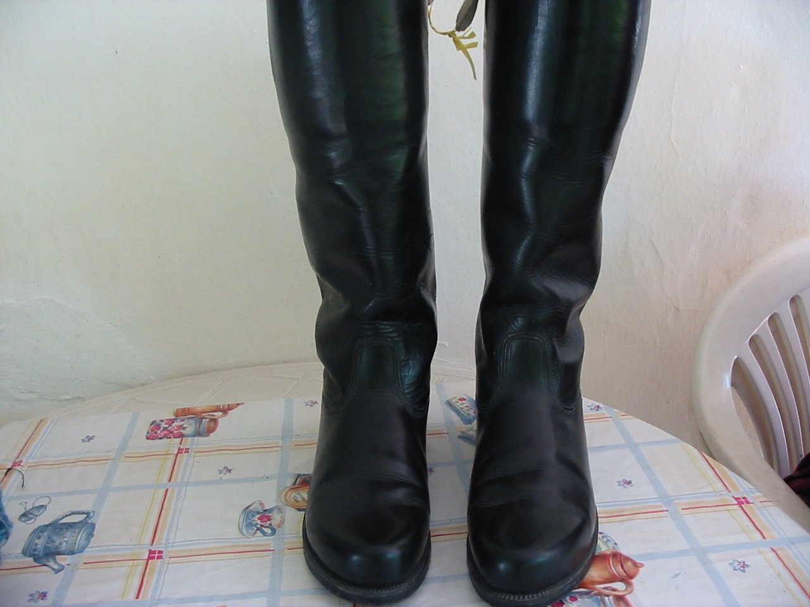
What has that got to do with it ?

Slide 4
Ultimate Goal
M O R A L
ECONOMICS
ECONOMICS
MORAL
Profit centered paradigm
(Political economics)
Virtue ethical paradigm
(Civil economics)

Slide 5
Virtue ethics: underground stream
IV. – I. B.C.:
Plato, Aristotle, Cicero
Middle ages:
Thomas Aquinas,
San Antonio, Scolastics
XV. – XVIII. century:
Italian Civil economy
Genovesi, A.
XIX. century:
Church’s Social Teaching
XX. century:
Social market economy
Civil society
Alternative economics

Slide 6
Stefano Zamagni, 2014
Profit centered paradigm
(Political economics)
Virtue ethical paradigm
(Civil economics)
NOMA principle 1829, Oxford Integration principle, 1765-69
Italy, Lezioni, Genovesi
economy, ethics, politics
Social welfare: Common good:
sum of goods multiplication of goods
n
∑
n
a
∏
i
a
i= 1
i
i= 1
No reciprocity principle Reciprocity principle
homo hominis lupus homo hominis natus amicus
Homo oeconomicus homo reciprocans
market
market
redistribution
redistribution
Civil society/reciprocity

Slide 7
FINANCIAL TIMES 23 September 2014
„Economics faculties rethink formulas
…Since the financial crisis, student groups have attacked
economic departments for failing to deal with the world’s
most pressing social issues, including inequality and global
warming. They have also criticised professors’ reluctance
to teach a range of economic theories, with courses
instead focusing on neoclassical models which they claim
do little to explain the 2008 meltdown.
…exposure to a wider range of approaches is necessary
…more emphasis on economic history
…more pluralism in economics
…more alternative voices
…more openness to [methods from] other social sciences”

Slide 8
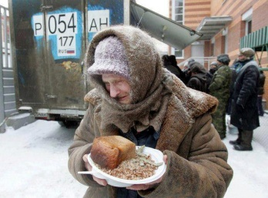
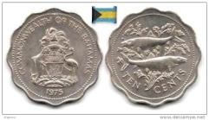
Aristotle: Politics
Daily – Cobb, 1989
C-M-C’
OIKONOMIA
CHREMATISTICS
M-M’
Franciscans, XV. century
MONTI DI PIETA M-M’(C)

Slide 9
Moral value of the human act
Consequencialism (Chrematistics), Mill
Intention (will)
(goal)=result, outcome
Reason /motivation = „sentiment”, WHY
Thomism (Oikonomia), Thomas Aquinas
Fair trade
Intention (will); reason (motivation); object; circumstances; concrete goal

Slide 10
San Antonio: Summa Moralis, XV. century, Florence
„…The whole justification of trade lay in the intention
of the trader.”
„The object of gain is that by its means man may provide
for himself and others according to their state.
The object of providing for himself and others is that they
may be able to live virtuously. The object of a virtuous
life is the attainment of everlasting glory.”
In: Jarrett, B., 2007

Slide 11
„GOOD”
subjective or objective?
HAPPINESS – EUDAIMONIA
- fulfillment by virtues
- human relations
- spiritual life
eternal law; natural law
ULTIMATE GOOD
universal norms; ethical norms
real „good”
fulfillment
apparent „good”
human relations

Slide 12
HIERARCHICAL ORDER OF THE „GOOD”-S (VALUES)
Aristotle: EXTERNAL GOODS (tools) – GOODS OF BODY– GOODS OF SOUL
Classical philosophy
Contemplating truth
Thomas Aquinas
Ultimate goal
Maslow, A.
Transcendent needs
Intellectual,
moral
living being
Self-
Actualization
Intellectual, moral values
Living being
Self-Esteem
Moral good
Belongingness
Pleasant good
Economic, vital values
Useful good (tool)
Safety
Being
Physiological
Hierarchy Hierarchy
of being of values
Order of the „goods”
S.Th. I.q.5., a.6.
Hierarchy of needs
Alford-Naughton [2001], 43.
Baritz, 2014

Slide 13
THREE DIMENSIONAL ECONOMY
1.- 2. DIMENSIONS 3. DIMENSION
FOUNDATIONAL GOODS EXCELLENT GOODS
(infinite values)
we strive for them to obtain we strive for them
other goods, they are tools for their own sake, they are goals
Moral goods
Pleasant goods
Reciprocity,
Relational goods,
Cooperation,
Gratuitousness,
Generosity,
Trust,
Solidarity,
Justice,
Temperance.
Useful goods
Nice work Value
environment, character of
Job the environment,
satisfaction, Recreation
Cultural value of the
economic environment
atmosphere
Investment goods,
Marketing strategy,
Financial means,
Profit
Market mechanisms are valid in the realm of foundational goods!
Goal of economy: common good.
Ultimate Goal
Excellent goods=Moral good
Foundational goods=Useful good
Baritz,2014; Alford-Naughton, 2001

Slide 14
PLACE AND ROLE OF PROFIT AND MONEY
Profit centered paradigm Virtue ethical paradigm
PROFIT an end in itself tool
utility useful good
rules serves
its place: is not on its place, not natural is on its place, useful good, natural
its goal: maximization serve moral goods, common good
motivation: greed, accumulation, M-M’ concrete, good goal, M-M’(C)
chrematistics oikonomia
MONEY ultimate goal servant of the servants
accumulation is subordinated to
use of money
MONEY
Excellent goods
Foundational goods
money
Baritz, 2014

Slide 15
Homo Oeconomicus
unhappy,
missed his/her goal
Homo Reciprocans
Ultimate Goal
Useful goods
Moral goods
Useful goods
Moral goods
Values
reduction (two dimensions) whole person, three dimensions
exchange of equivalents, contract exchange of equivalents, contract + values
reciprocity, trust, solidarity, …
non-tuism, (I-IT) tuism, (I-YOU),
subjectivist self interest objectivist self interest
Baritz, 2013

Slide 16
OBJECTIVIST SELF INTEREST (Eric Fromm, 1949)
- My self-interest includes
the interests of the others,
as well.
- Fulfillment with the help of the
virtues.

Slide 17
GOAL OF ECONOMY:
creating the common good,
profit is a tool to reach it.
COMMON GOOD:
human fulfillment both on
the level of the individual
and the community.

Slide 18
∑: This was
HUMAN CENTERED ECONOMICS
based on
Church’s Social Teaching
and others, like:
Amartia Sen, Karl Polanyi, Tibor Scitovsky, R.H. Frank, Amitai Etzioni, Charles Taylor, R.E. Freeman, Francis Fukuyama, Richard Easterlin,
Herman Daly, Albert Bandura,
Stefano Zamagni, Luigino Bruni,
Helen Alford, Michael Naughton,
Arjo Klamer, David Lutz, Kenneth Lux,
Tim Kasser, Eric Fromm, E.L. Deci, R.M. Ryan, Martin Buber, István Muzslay,
Carl Rogers, Abraham Maslow,
Antonio Genovesi, XVIII. century

Slide 19
Papal encyclicals, documents
Leo XIII: Rerum Novarum 1891
Pius:XI: Quadragesimo Anno 1931
John XXIII: Mater et Magistra 1961
John XXIII: Pacem is Terris1963
Vatican Council II: Gaudium et Spes 1965
Paul VI: Populorum Progressio 1967
Paul VI: Octogesima Adveniens1971
Sinode of the bishops: De Iustitia in Mundo 1971
John Paul II: Laborem Exercens 1981
Cong for the doct of faith: Libertatis Nuntius 1984
Cong for the doct…: Libertatis Conscientia 1986
John Paul II: Sollicitudo rei Socialis 1988
John Paul Il: Centesimus Annus 1991
Benedict XVI: Caritas in Veritate 2009
Pope Francis: Evangelii Gaudium 2013
Contemporary authors
Alford, Naughton, Muzslay, Kavanaugh, Cortright, Kocsis, Baranyi, Baritz, Kindler, Tóth, Turgonyi, Williams, Marx, Kennedy, Novak, MacIntyre,Solomon, Bruni, Zamagni, Vertraten, Melé, Argandona, Perez Lopez, Ferrucci, Goodpaster, McCann, Araújó, Lubich, Kasser, Clark, Barrera,
Freeman, Cornwall, Egom, Etzioni, Wicks,
Parmar, Frey, Kopp, Skrabski, Lenhardt, Beran, Lutz, Lux, McInerny, Oderberg, Pinckaers,Passmore, Porter, Rocha, Goshal, Rosanas, Lecocq, Frontiero, Habisch, Kennedy,…
Centers
Pontifical Council for Justice and Peace; Pontifical University of St. Thomas , Rome; University of St. Thomas, St. Paul, Minesota; John A. Ryan Institute for Chatolic Social Thouht, St Paul Minesota;University of Notre Dame, Notre Dame, Indiana; Leuveni Katolikus Egyetem; Navarrai Üzleti Iskola; Universities: Florida, Huston, Washinton, Portland, New Orlins, San Diego, Fredicton (Kanada), Manila,Osaka, Zurich, Etiopia, Budapest, …

Slide 20
Basic principles
COMMON GOOD
Human dignity
SOLIDARITY
SUBSIDIARITY
JUSTICE

Slide 21
REGULATING ROLE OF THE PROFIT
CENTESIMUS ANNUS 35, 1991
The Church acknowledges the legitimate
role of profit as an indication
that a business is functioning well.
When a firm makes a profit
, this means that productive factors
have been properly employed and
corresponding human
needs have been duly satisfied.
But profitability is not the only
indicator of a firm's condition.
In fact, the purpose of a
business firm is not simply to
make a profit, but is to be found
in its very existence as a
community of persons who
in various ways are
endeavouring to satisfy their
basic needs, and who form a
particular group at the service
of the whole of society.
Profit is a regulator of the life of a business, but it is not the only one; other human
and moral factors must also be considered which, in the long term, are at least
equally important for the life of a business.
John Paul II

Slide 22
Civil economics
Political economics

Slide 23
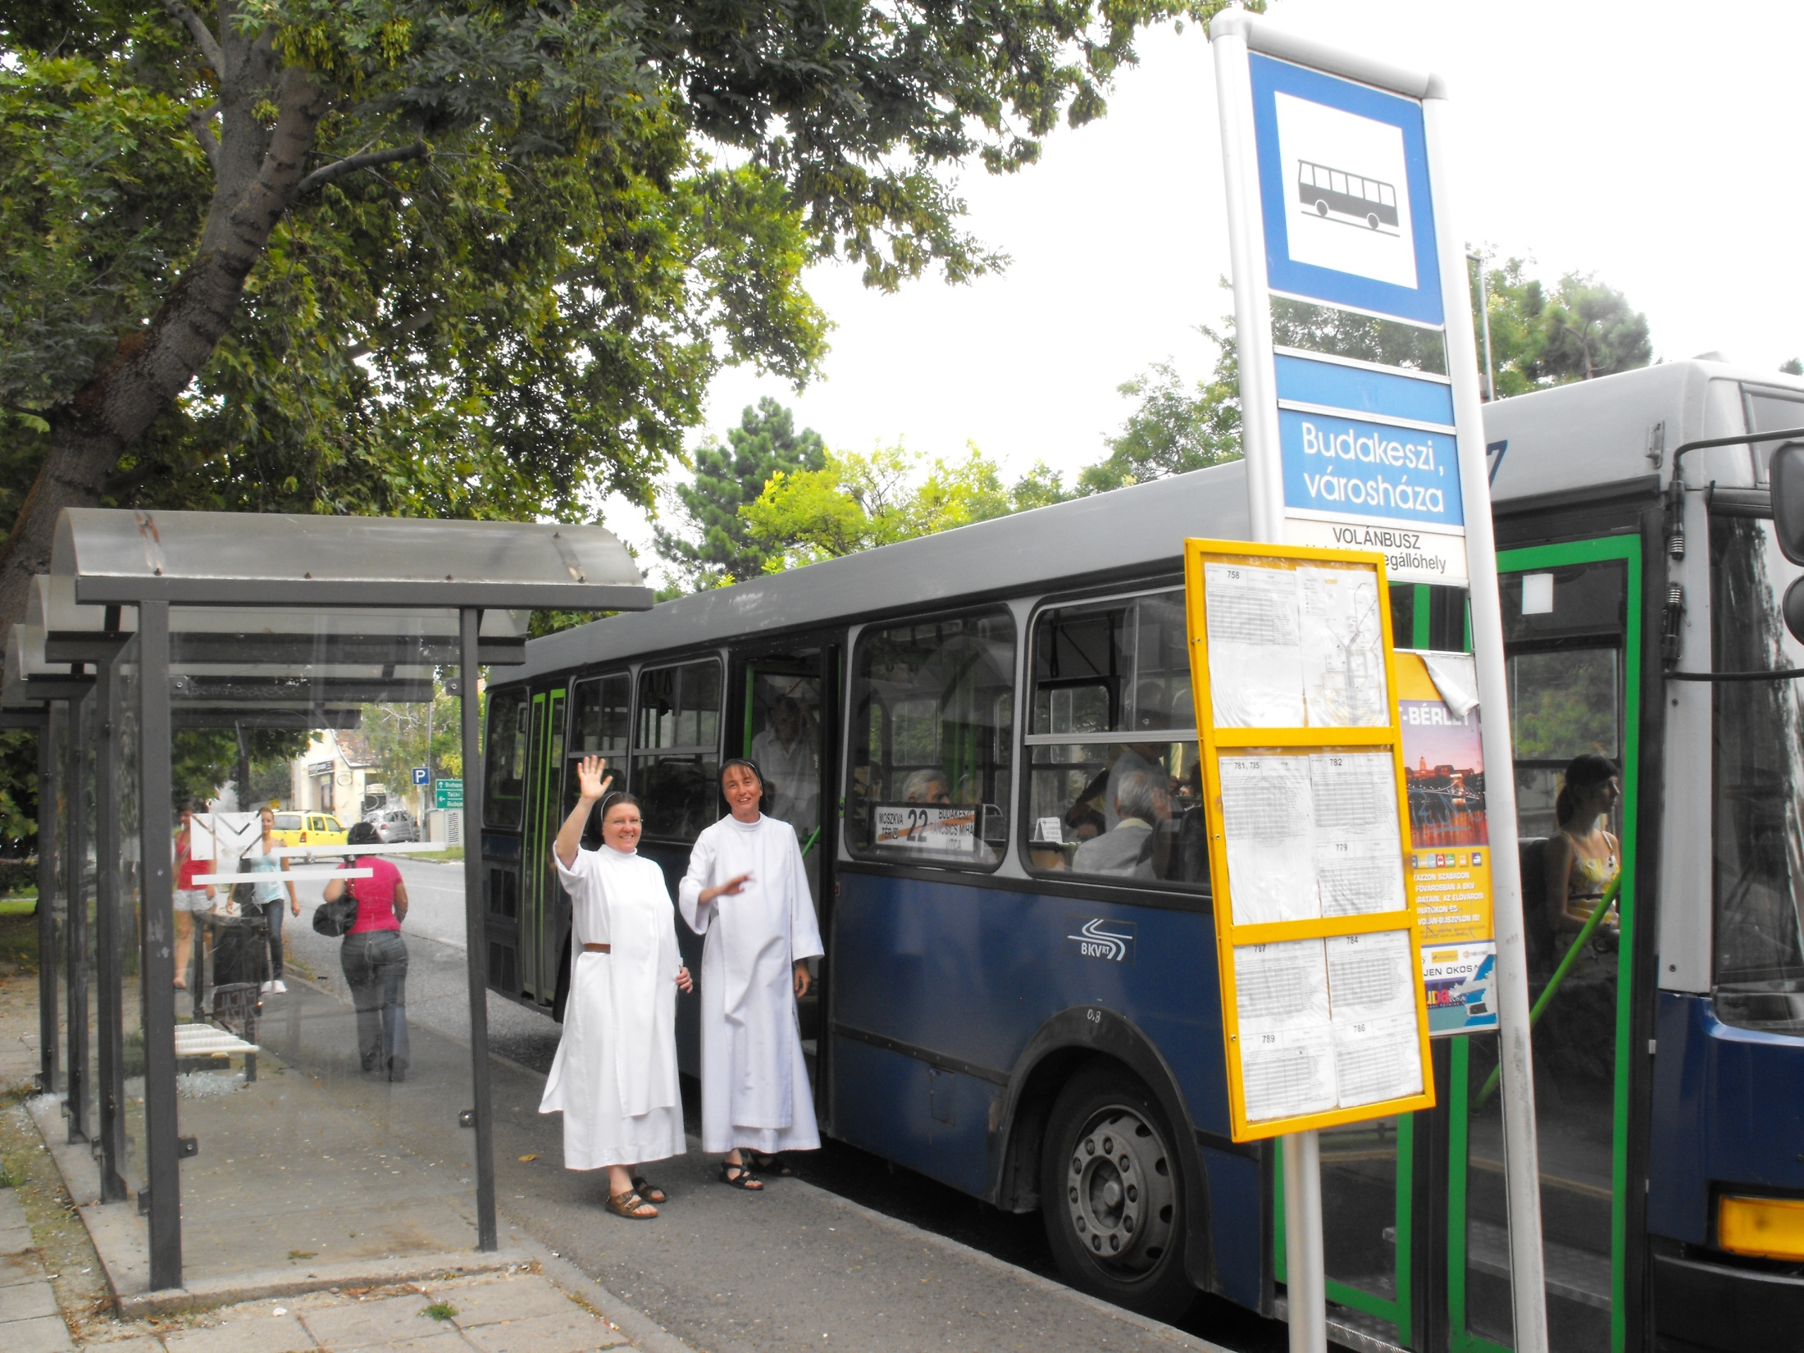

Slide 24
THANK YOU

